Slide 1
Primer Optimization for Multiplex PCR
Ria Noble - Biostatistics

Slide 2
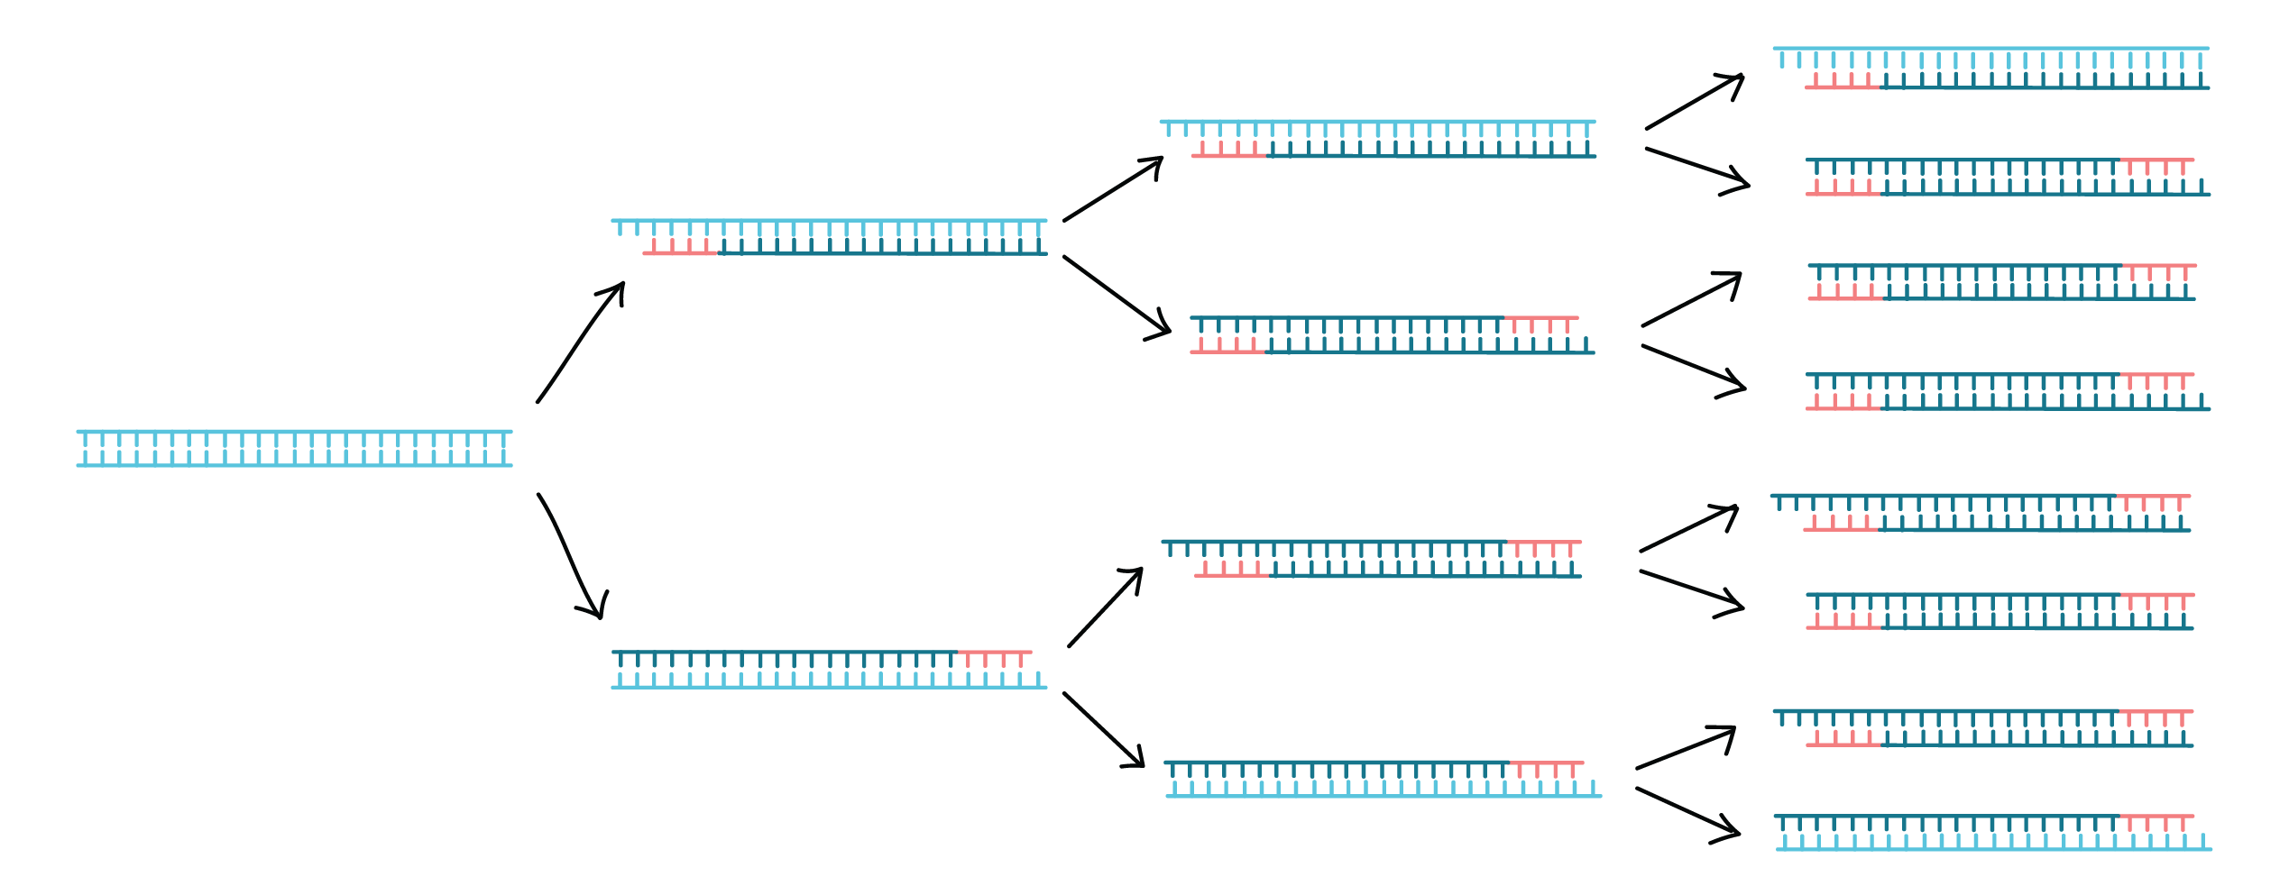
What is PCR?
DNA amplification process
Requires template and primers

Slide 3
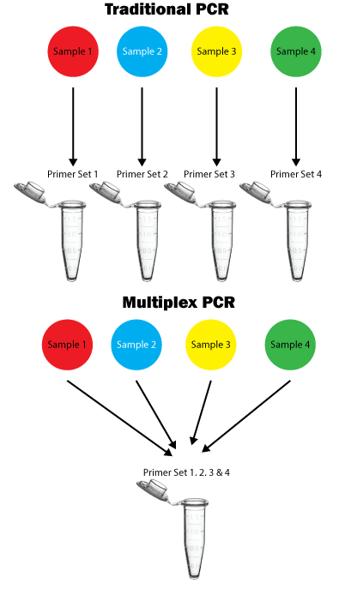
Multiplex PCR
Amplifying multiple different DNA strands in one solution
More cost-effective
More informational output with less sample
Less time, less pipetting (moving samples)

Slide 4
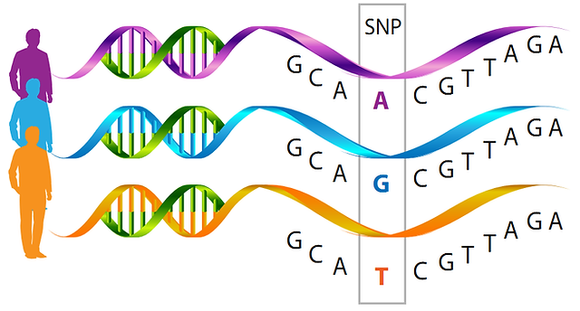
What is a SNP?
SNP – Single Nucleotide Polymorphism
Many associated with metabolic diseases
Lab sought to reduce primer designing time

Slide 5
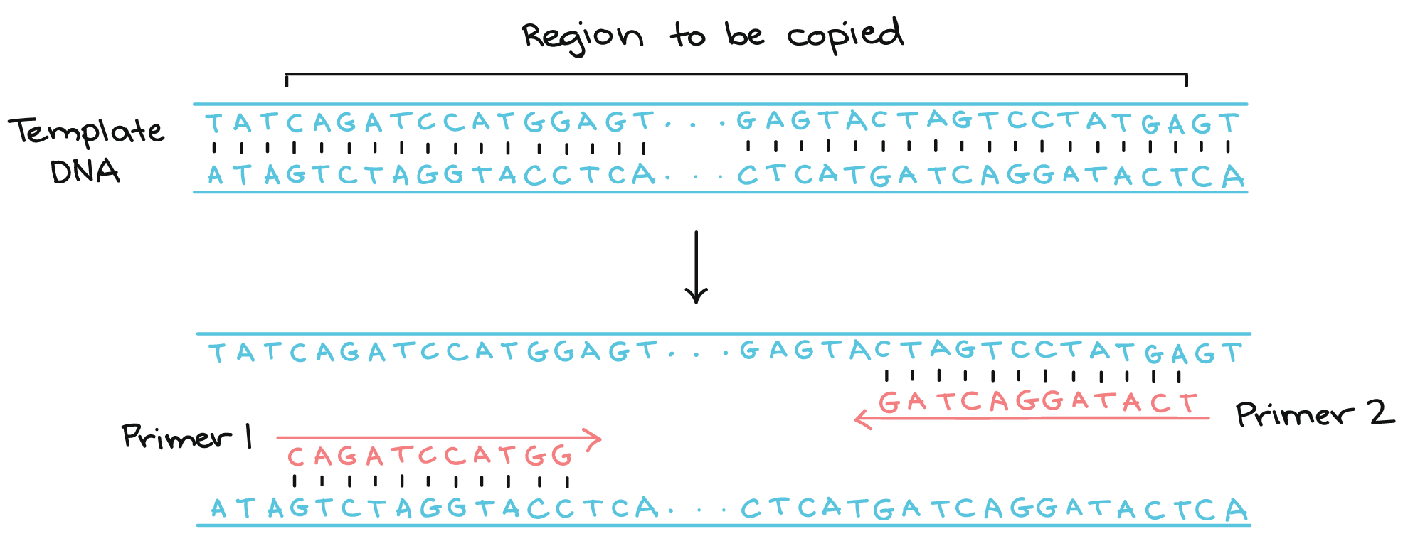
SNP-Specific Primers

Slide 6
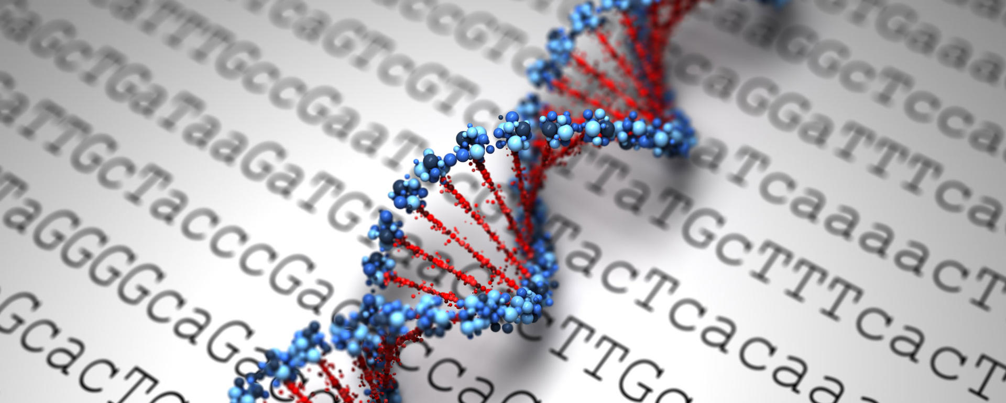
Objective
Shorten process of primer design
Avoid interaction between primers
Keep all primers at similar melting temperature
Accessible app for biology lab
Generate best options for multiplexing certain SNP IDs together

Slide 7


The Process
Grab all primer candidates for each SNP ID
Eliminate those that self-interact
Reduce primer cross-interaction
Output best options based on overall interaction
Implement extra requests at lab’s suggestions

Slide 8

Pseudocode
get_primer_candidates
Pull DNA sequences from database
Generate all primer candidates with string functions
get_self_filter
Filter on melting temp (45 < x < 70)
Filter on homodimer ΔG (measurement of self interaction)
get_cross_filter
Evaluate pairs on close temp and heterodimer ΔG (measure of cross interaction)
get_final_list
Compile all full combinations that work
Filter out groups with temp differences (>1)
Sort by lowest heterodimer

Slide 9
The Result
Summary of best combinations
Final Table
Contains all information on primers – temps and interaction measures
Ordered by worst interaction

Slide 10
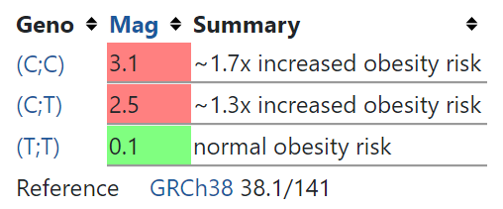
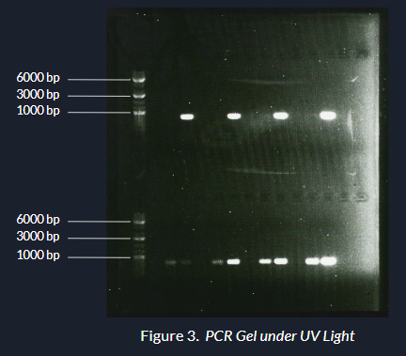
Testing
Focus on rs1421085
Associated with increased obesity risk
Successful amplification
Potential for specific binding found

Slide 11

Challenges
Debugging code – previous student was CS major
get_final_list function
Had to rely on random sampling instead of all combinations
Communicating with biology and DS/CS majors
Lack of statistics opportunities
The interdisciplinary experience

Slide 12


Any Questions?

Slide 13
Sources
https://cdn.kastatic.org/ka-perseus-images/41f0e0fd8b49ba824db0eb707015557bb72ae72b.png

Slide 14
What are Probes?
Designed to bind downstream of primers
Fluoresce when reaction occurs
Goal is to design them for each SNP ID we are multiplexing
Can also disrupt the reaction with interaction
We can use similar mechanisms engineered for primers to minimize interaction

